Slide 1
Spring boot building bootiful code

Slide 2

Spring vs Java EE

Slide 3

My first round with boot

Slide 4
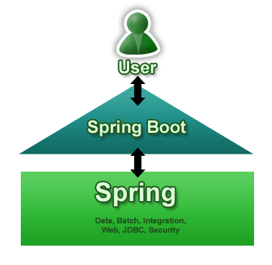
The main thing

Slide 5
Key features
Stand-alone application
No code generation and no xml config
Automatic configuration
Starter dependencies

Slide 6
Building blocks
Spring application concept
@EnableAutoConfiguration
@ConditionalOnClass
@ConditionalOnBean
@ConditionalOnMissingBean

Slide 7
Starters
Spring-boot-starter
Spring-boot-starter-web
Spring-boot-starter-test
Spring-boot-starter-actuator

Slide 8
Talk is cheap. Show me the code.

Slide 9
Actuator
Monitoring endpoints
/health
/Info
/metrics
/trace
JMX/ssh

Slide 10
How does it help?
Reduces boilerplate code
Simplifies app maintenance
Gives you a field to play …. In a timely manner.

Slide 11

Do it Hipster way

Slide 12
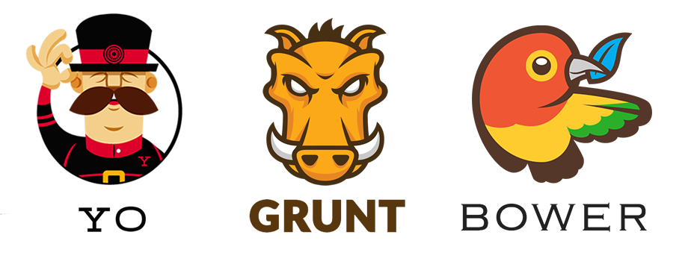


Hipster way

Slide 13
What else
Jhipster
http://www.lordofthejars.com/2014/09/apache-tomee-shrinkwrap-javaee-boot-not.html
https://blog.codecentric.de/en/2014/08/spring-boot-starter-batch-web-1-2-0-released/
Spring boot start guides

